Slide 1
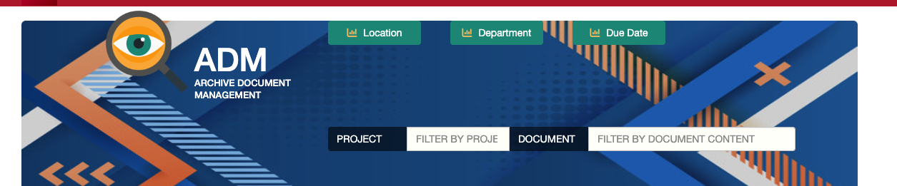
ADM User Guide
Guide for Document Storage and Management

Slide 2
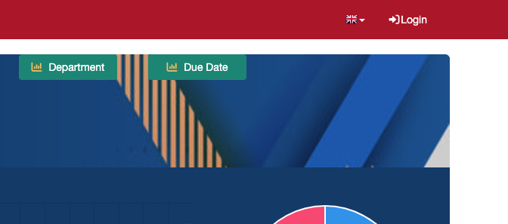
Accessing the Application
Navigating to the Web Site
Go to adm.quasarpm.com
Login
Enter your credentials

Slide 3
User Interface

Slide 4
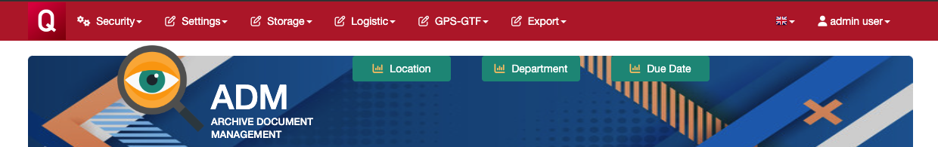
Main Menus
Security
Users and Roles Management
Settings
Account, Projects, Group/Department and Retention Codes Management
Storage
Box and Documents Management
Logistic
Site, Area and Section Management
GPS-GTF
Procedures and Forms Managements
Export
Data exporting in Standard Formats (as for GPS-GTF)

Slide 5
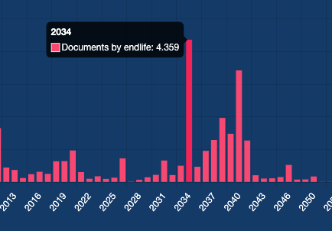
Dashboards
Location
Boxes by Location
Department
Records by Group/Department
Due Date
Records by Due Date
All charts allow the export of their respective records. For example, "all records with retention date 2034".

Slide 6
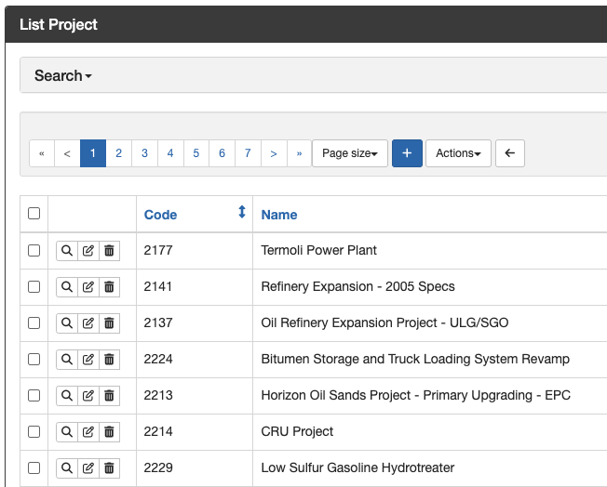
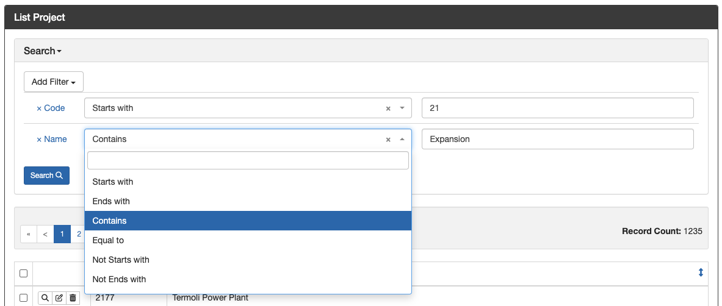
Records List
Search by Filter
All views allow the management of records:
Create a new record (icon: +)
Show a record (icon: magnifying glass)
Edit a record (icon: edit)
Delete a record (icon: delete)
All views allow the search of records by applying one or more conditional filters.

Slide 7
Setup

Slide 8
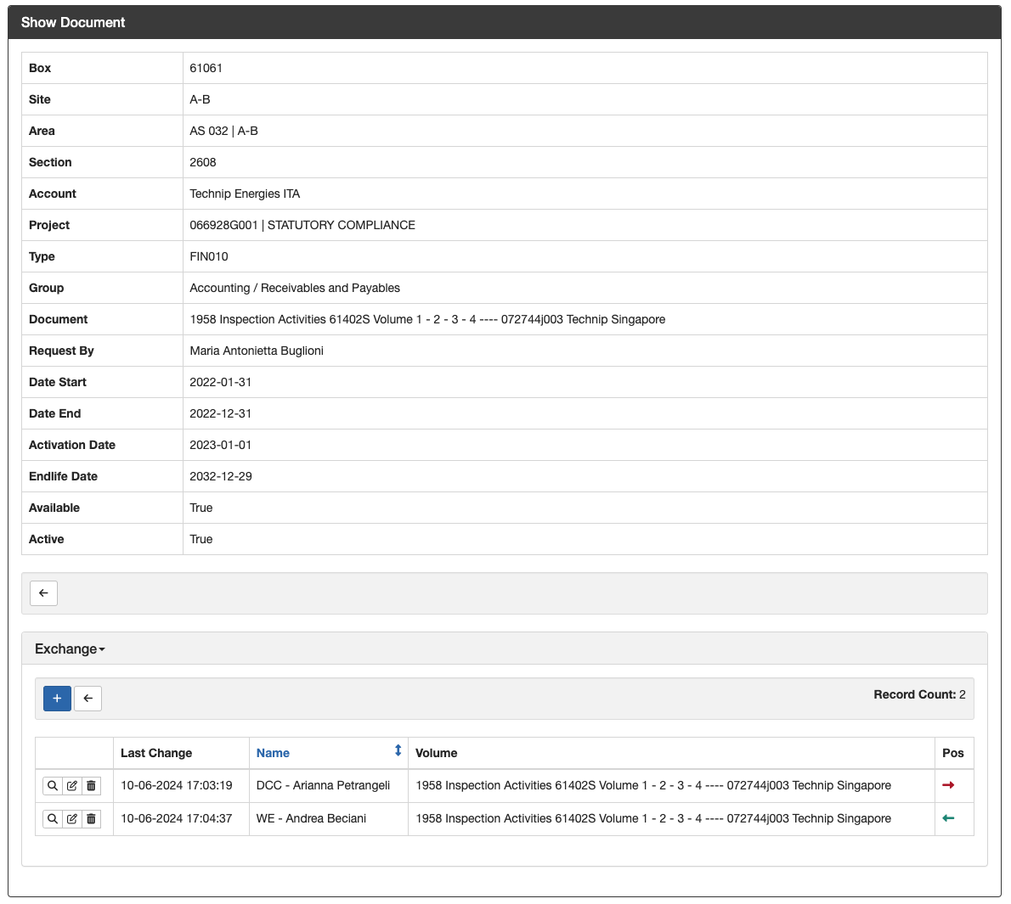
Logistic Example
Account
Site 1
Area 1
Section 1
Section 2
Area 2
Section 3
Box 1
Box 2
Doc Record 1
Doc Record 2
Doc Record 3
Box 3
Section 4
Site 2
Area 3
Section 5
Section 6
Area 4
Section 7
Section 8
Doc Record 4
Doc Record 5
Doc Record 6
The retrieval and return of documents are recorded in the Exchange view.

Slide 9
Settings Example
The retrieval and return of documents are recorded in the Exchange view.

Slide 10
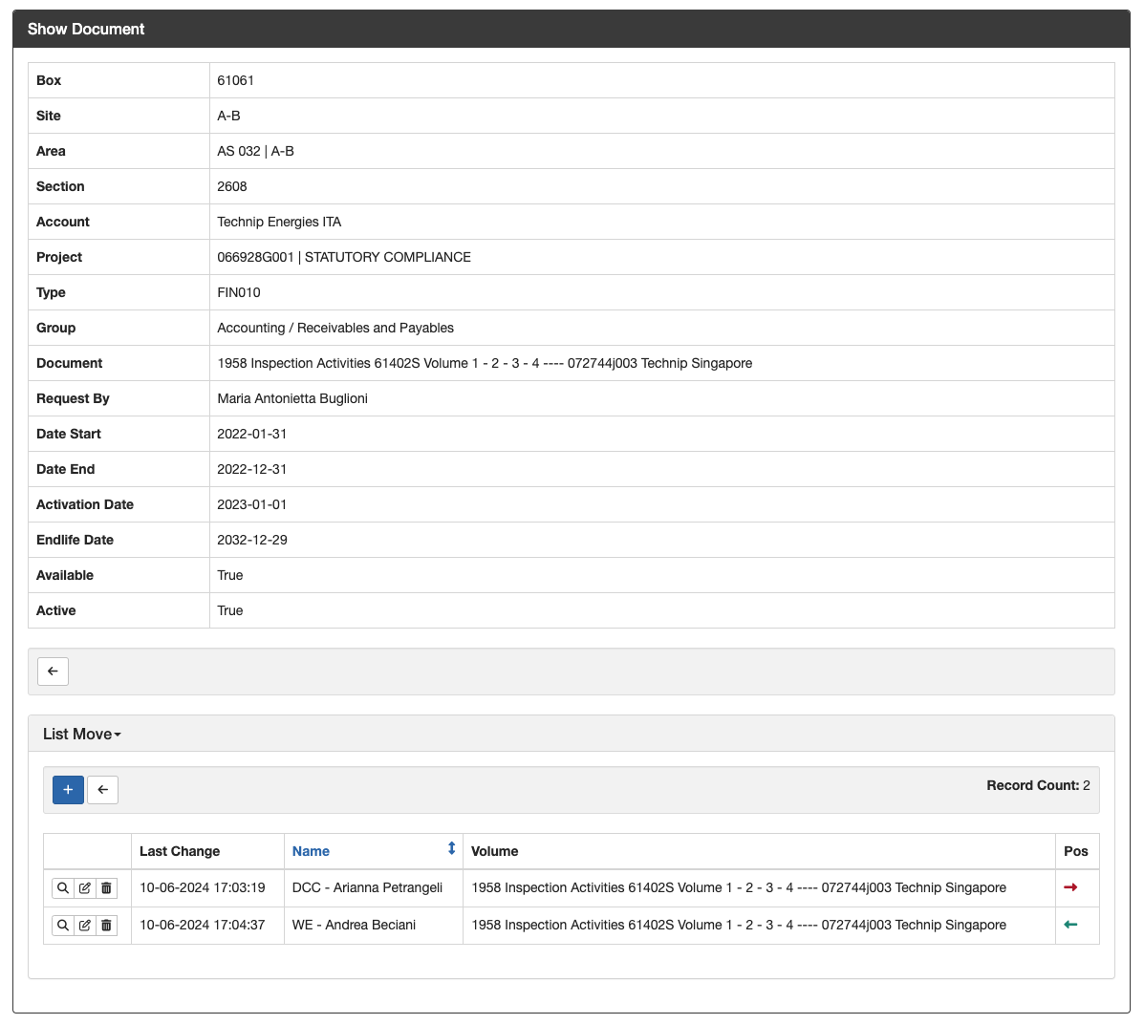
Logistic Setup Example
Account
Site 1
Area 1
Section 1
Section 2
Area 2
Section 3
Box 1
Box 2
Doc Record 1
Doc Record 2
Doc Record 3
Box 3
Section 4
Site 2
Area 3
Section 5
Section 6
Area 4
Section 7
Section 8
Doc Record 4
Doc Record 5
Doc Record 6

